Slide 1
ADA section Algorithms, Data and Artificial Intelligence
Algorithms, Data Structures and Foundations of Machine Learning (Contact: Chris)
Data-Intensive Systems (Contact: Akhil)
Computational Complexity and Game Theory (Contact: Kristoffer)

Slide 2
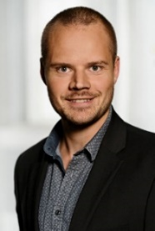
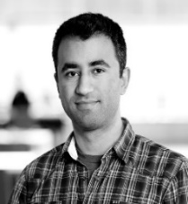
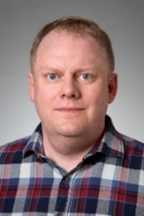
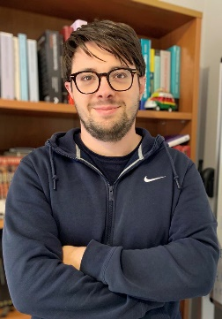

Bachelor projects in Algorithms
A typical BSc project (and MSc thesis) consists of
reading and understanding in depth one or more research papers
getting an overview of related results in the literature
implementing one or more algorithms / data structures
experimental evaluation of the implementation
writing a report summarizing all the above, incl. rephrasing central theory
Depending on ambition of the project group and the progress during semester
technical complexity of algorithms considered
balance between theory / implementation / experimental evaluation
confirm known experiments / first implementation / novel research
project description adjusted based on progress
Kasper
Peyman
Gerth
Courses | BSc | Algorithms and Data Structures (CS, 1st semester, Brodal) Computer Architecture, Networks and Operating Systems (CS & IT 4th semester, Afshani) Machine Learning (CS, 5th semester, Larsen) Introduction to Programming with Scientific Applications (non-CS, Brodal)
 | MSc | Computational Geometry: Theory and Experimentation (CS, 1st semester, Afshani) Randomized Algorithms (CS, 2nd semester, Larsen) Cluster Analysis (CS, 2nd semester, Schwiegelshohn)
Andrea
Chris

Slide 3
, Peyman Afshani associate professor Computational geometry External memory algorithms
Gerth Stølting Brodal professor Data structures External memory algorithms
Geometric Algorithms
Data set corresponds to points in Euclidean space.
Design algorithms and data structures exploiting geometry.
Problems offered:
Closest Points
Recreate and implement optimal algorithms for 2D and 3D
Coresets for Minimum Enclosing Ball.
Find a sphere with minimum radius covering points
Crossover with scalable algorithms: be fast when number of points or dimension are large
Shortest Paths on Open Street Map
Do a better job than Google Maps

Slide 4
Chris Schwiegelshohn associate professor Sketching Approximation Algorithms
Andrea Paudice assistant professor Machine Learning Optimization
Scalable/Learning Algorithms
Streaming model:
Data points are submitted one after another.
Answer questions about the data, but do not store the entire data set.
Problems offered:
Decide whether a graph is connected.
Determine the number of non-zero elements in a vector.
Optimization:
Gradient descents iteratively improve a current solution by inching closer to the optimum.
Problems offered:
Compare different gradient descents for linear regression.

Slide 5
Kasper Green Larsen associate professor Data structures Lower bounds
Chris Schwiegelshohn assistant professor Machine learning Dimension reduction
Learning Algorithms
Streaming model:
Data points are submitted one after another.
Answer questions about the data, but do not store the entire data set.
Different degrees of difficulty depending on problem, type of data, type of updates, etc.
Problems offered:
Connectivity:
receive edge updates
decide whether a graph is connected
Distinct Elements:
receive updates to a vector
decide how many non-zero entries the vector has

Slide 6
Data-Intensive Systems (DIS)
Bachelor project proposals 2026
Akhil Arora, Davide Mottin, and Ira Assent
Notes:
Hello Everyone and Good morning
My name is Akhil, and today, I will give you a brief overview of the Bachelor projects offered by the Data-Intensive Systems Group, highlighting why you should work with us ☺.

Slide 7
The DIS Group
Our interests
Data management [1], data science [2], natural language processing [3], machine learning, computational social science [4], and artificial intelligence
Models and algorithms
Efficiency, scalability, and interpretability
Our methods
Formalize real-world problems
Devise concepts and algorithmic solutions
Evaluate empirically
Our tools and results
Theoretical analysis, meaningful insights, and prototype implementations
[1] https://cs.au.dk/research/algorithms-data-and-artificial-intelligence/databases
[2] https://cs.au.dk/research/algorithms-data-and-artificial-intelligence/data-mining
[3] https://cs.au.dk/research/algorithms-data-and-artificial-intelligence/natural-language-processing
[4] https://cs.au.dk/research/algorithms-data-and-artificial-intelligence/computational-social-science
Notes:
Interests:
Our group is highly interdisciplinary: among the three of us, we have expertise in data management and data science, NLP, AI/ML, and CSS.
What ties us together? we design models and algorithms with a special focus on efficiency, scalability, and interpretability.
[Click] Methods: Our approach to problem solving involves the following three-step process:
Start in the wild, and map real-world problems to abstract CS problems
Devise models and algorithms to solve the problem, and
then evaluate their effectiveness empirically.
[Click] Usual artefacts generated from our research include, but are not limited to, theoretical analysis, meaningful insights from raw data, and prototype implementations/tools.

Slide 8
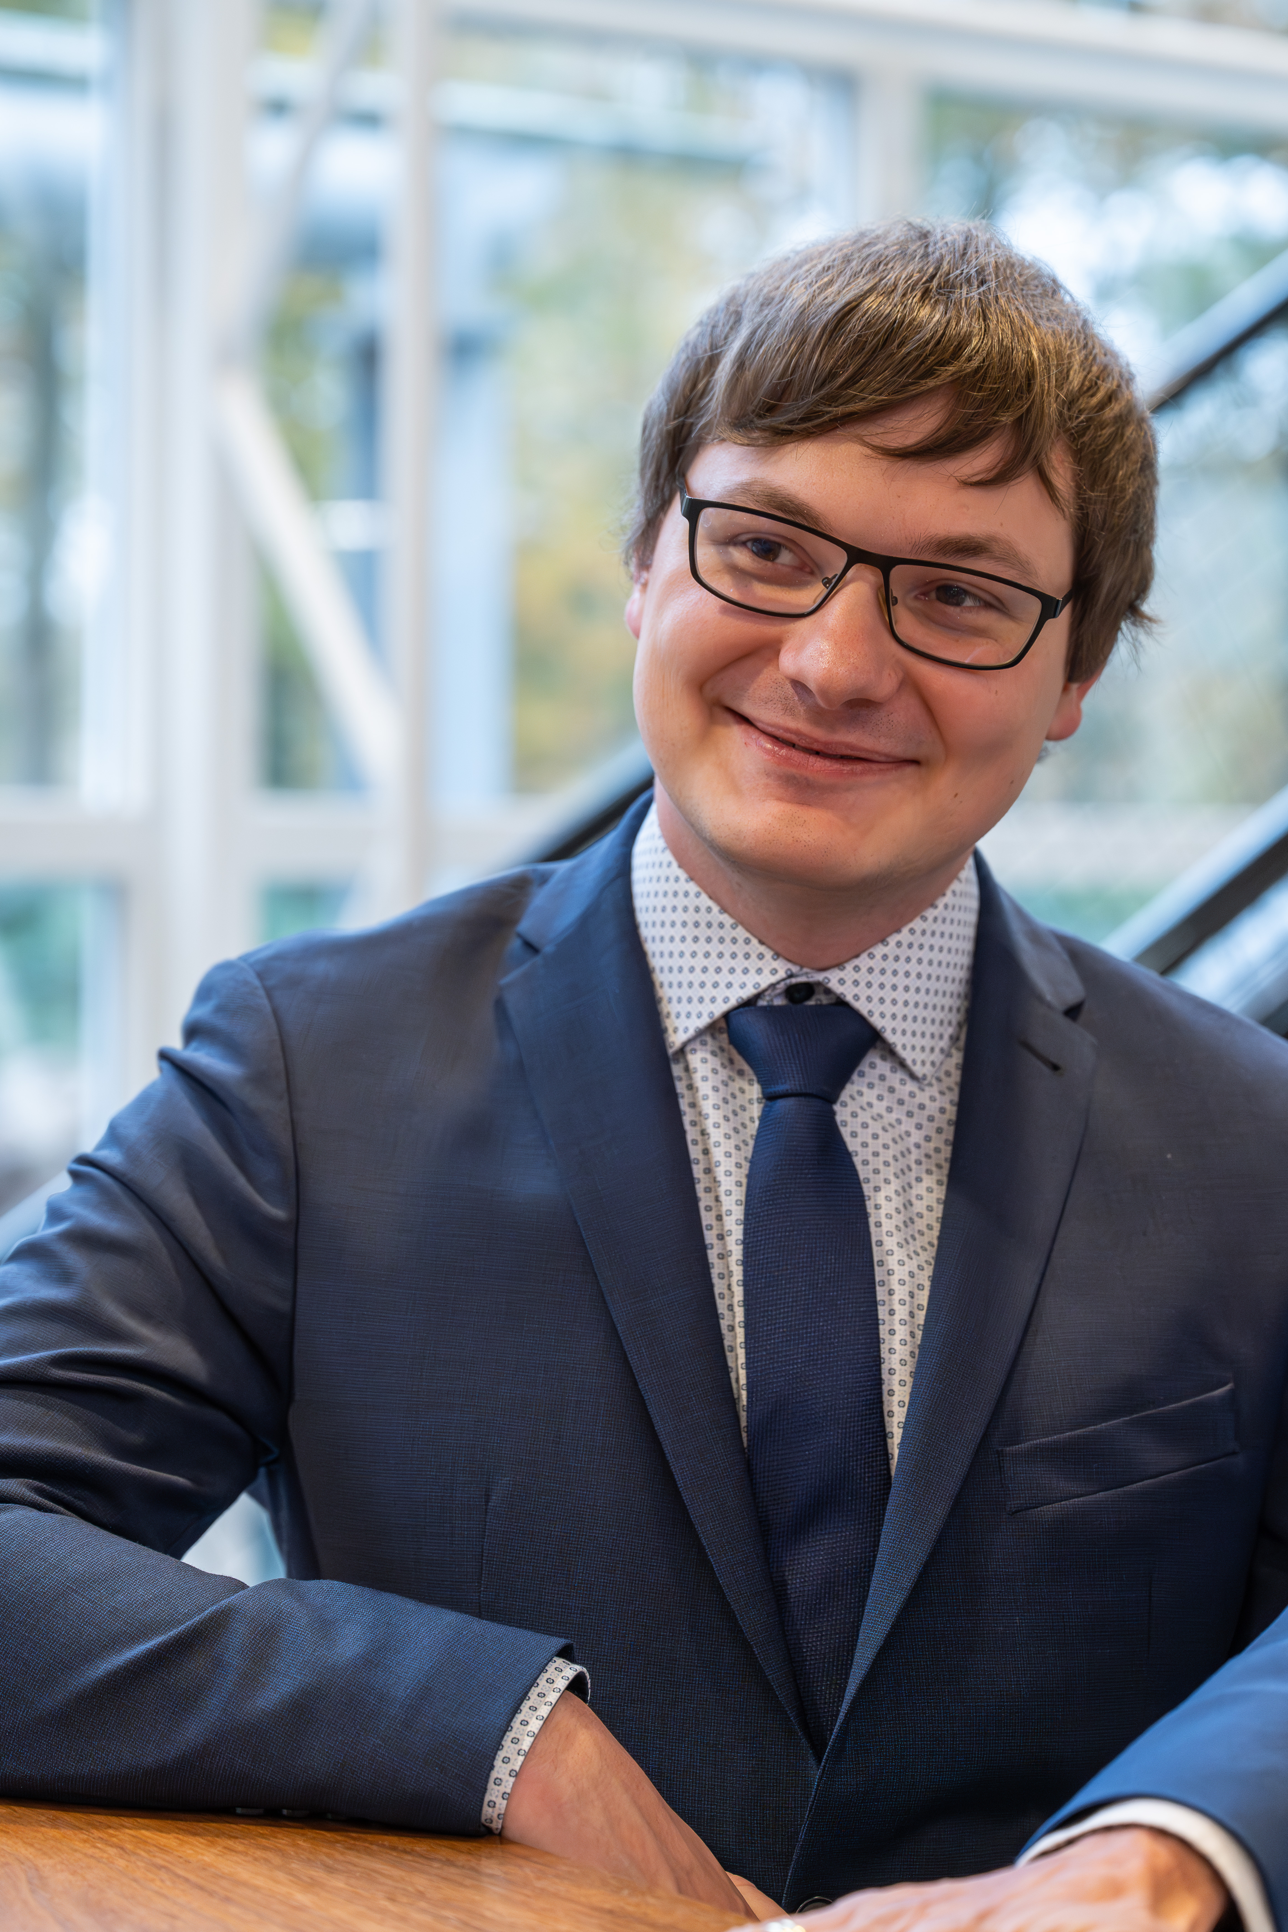

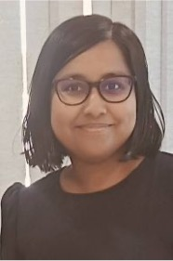

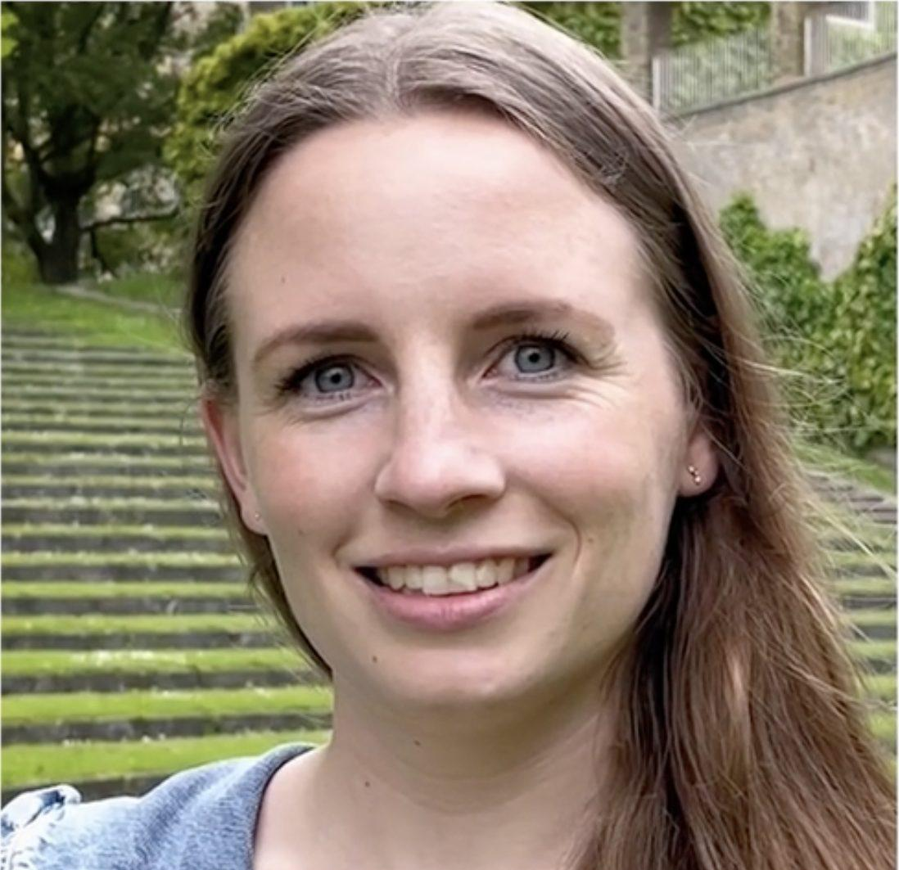

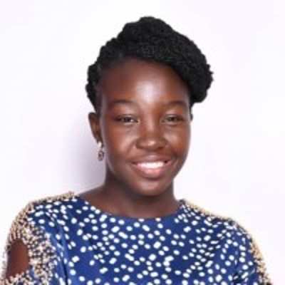
Our great supervisory team
Maximilian Egger
PhD student
Nearchos Potamitis
PhD student
Ankita Maity
PhD student
Kasper Overgaard Mortensen
PhD student
Amalie Brogaard Pauli
PhD student
Cheng Huang
PhD student
Ama Bembua Bainson
PhD student
Notes:
In addition to the professors in the group, here is our amazing team of co-supervisors with whom you will get a chance to work with should you choose a project from our group.

Slide 9
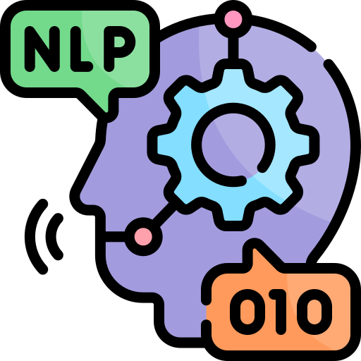

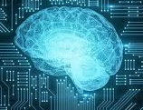

Projects in a Nutshell
Red²: Redundancy Reduction in Graphs
CriticBench Evaluation with New Iterative Methods
Robust Multilingual News Collection Pipelines
GAG: Graph Algorithms marry GPUs
Natural Language
Processing
CacheSaver: Efficient, Cost-effective Experimentation with LLMs
BeG: A Benchmark for Graph Correspondences
Dynamic Query-Aware PathRank Summarization
Explainable AI
Can Bandits Count?
Artificial Intelligence
Graph Intelligence
Data Mining
Notes:
Enough publicity, now let’s get down to business!
I am sure most (and ideally all) of you have already read the detailed project descriptions, but here’s a zoomed-out bird’s eye view of the different projects offered and their role in the grand scheme of things, which should give you some perspective. The projects lie broadly in:
[Click] Graph Intelligence
[Click] AI
[Click] NLP and Data Mining

Slide 10

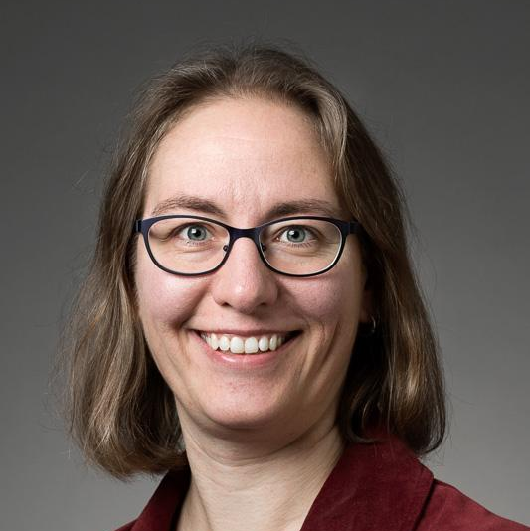
Graph Intelligence
Can we eliminate redundant graph attributes to make graph data cleaner, leaner, and easier to update?
Red²: Redundancy Reduction in Graphs
Can we redesign core graph algorithms to truly exploit GPUs and achieve massive speedups?
GAG: Graph Algorithms marry GPUs
Can we reliably match nodes across different graphs to evaluate and compare alignment methods?
BeG: A Benchmark for Graph Correspondences
Can semantic rankings in knowledge graphs be updated on the fly as queries evolve?
Dynamic Query-Aware PathRank Summarization
Notes:
Graphs are one of the most powerful ways of representing most real-world data, in fact, I am not exaggerating if I say graphs are ubiquitous: from the Web, to public transport systems, and from Genes to Chemical Compounds, we are surround by graph-shaped data.
Our group offers you the opportunity to work on real-world problems on graph-shaped data:
[Click] those listed in the slides
[Click] those listed in the slides

Slide 11
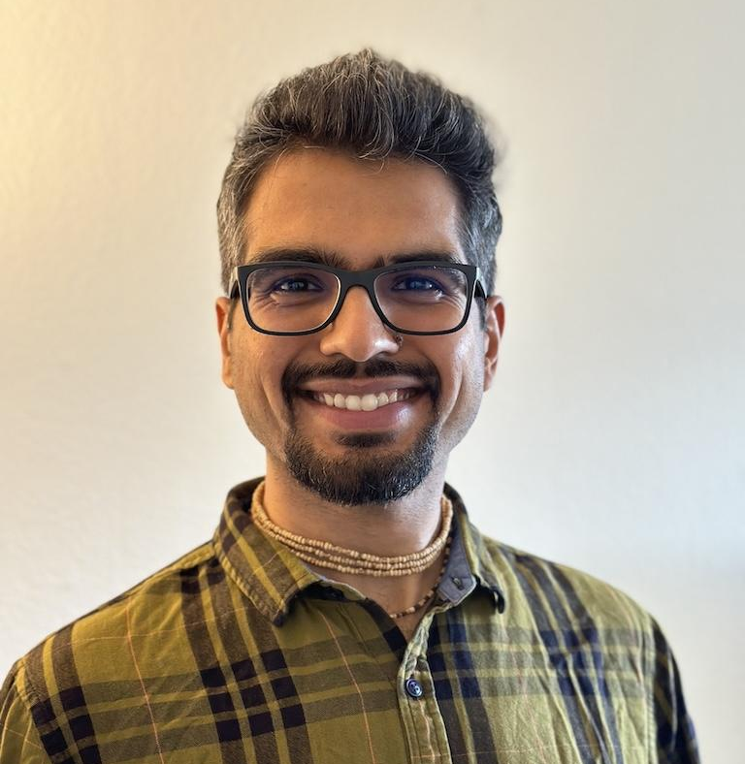
Artificial Intelligence
How can we enhance the explainability of AI-powered models?
Explainable AI
Can multiple rounds of self-critique help LLMs generate better reasoning and corrections?
CriticBench Evaluation with New Iterative Methods
Can we build scalable LLM applications that stay reproducible and cheap through smart caching?
CacheSaver: Efficient, Cost-effective Experimentation with LLMs
Notes:
If you want to build an attractive profile for jobs in the IT industry today, you can’t shy away from AI (and most importantly LLMs).
Work with us on exciting directions, such as:
[Click] Improving the explainability of AI models,
[Click] Devising Agentic AI-powered reasoning frameworks, and
[Click] Developing methods/tools for improving LLM decoding and inference.

Slide 12
Natural Language Processing & Data Mining
Can we build scalable pipelines that continuously collect fresh, multilingual news data and perform news analytics?
Robust Multilingual News Collection Pipelines
Can multi-armed bandits improve cardinality estimation when query workloads constantly shift?
Can Bandits Count?
Notes:
AI and graphs don’t interest you, not to worry, NLP and Data mining to the rescue ☺.. Come work with us on:
[Click] Develop a framework for collecting fresh, multilingual news data and perform large-scale news analytics.
OR
[Click] How about improving database optimizers, which are “still” the work horse behind most real-world systems in a variety of sectors such as banking, hospitals, public transport, and more.

Slide 13
Bachelor Projects 2026
Computational Complexity and Game Theory

Slide 14
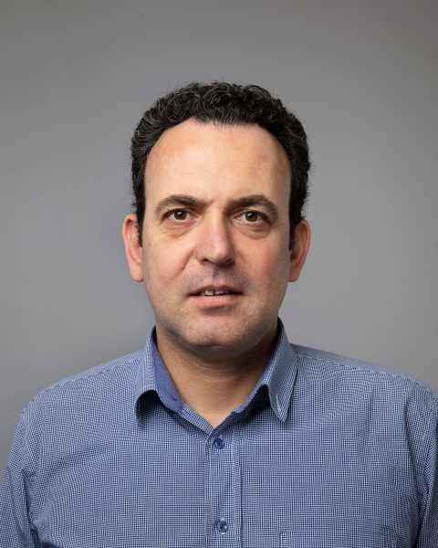
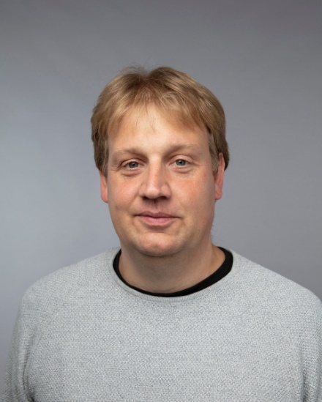

People
Ioannis Caragiannis
Kristoffer Arnsfelt Hansen
Stratis Skoulakis

Slide 15
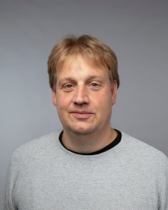
Courses
Randomized Algorithms (spring, master)
Algorithms, Incentives, and Data (fall, master)
Ioannis
Optimization (spring, bachelor)
Theory of Algorithms and Computational Complexity (fall, master)
Kristoffer
Machine Learning in Game Theory and Economics (spring, master)
Stratis

Slide 16
Projects
Fair division algorithms, Participatory Budgeting
Ioannis
Linear Complementarity Problems, Financial Networks
Kristoffer
Reinforcement Learning, Online Learning and Assembly of Calculus
Stratis

Slide 17
Final remarks
Projects can be tailored to suit your interests!
We are all on Incuba 4th floor. Come by and say Hi!
You are welcome to bring your own ideas for projects or just your thoughts about what you are interested in.

